Slide 1
Maths
Unit 6 – Fractions and Percentages.
29.09.2026
WALT:
6Nf.04 Recognise that fractions, decimals and percentages can have equivalent values.

Slide 2
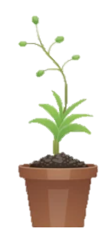
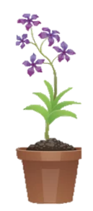

WALT: Recognise that fractions, decimals and percentages can have equivalent values.
I can find the fraction, decimal and percentage of a 100 square that is shaded.
I can convert between fractions, decimals and percentages.
I can order a mix of fractions, decimals and percentages.

Slide 3
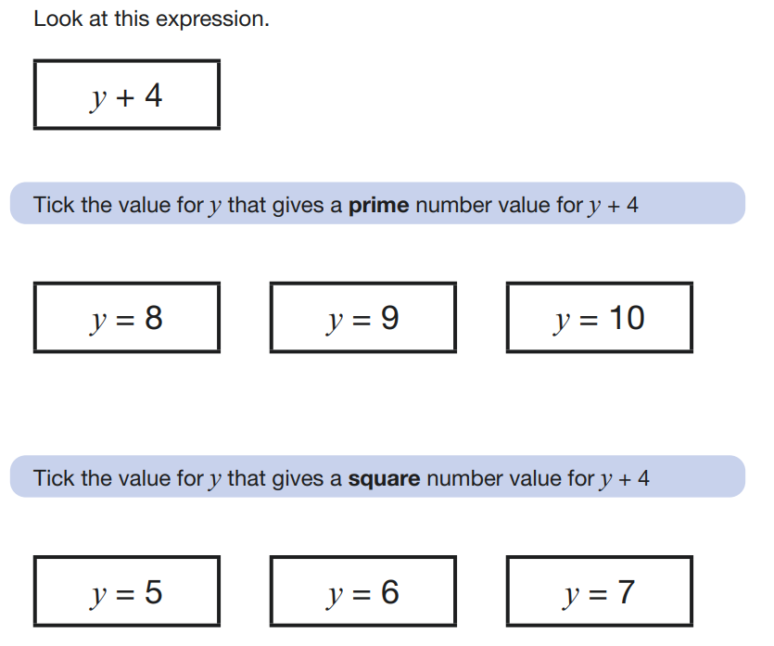
Retrieval Practice
WALT: Recognise that fractions, decimals and percentages can have equivalent values.

Slide 4
Starter – Which is the odd one out?
WALT: Recognise that fractions, decimals and percentages can have equivalent values.
50% of 100 =
½ of 100 =
100 X 0.5 =

Slide 5
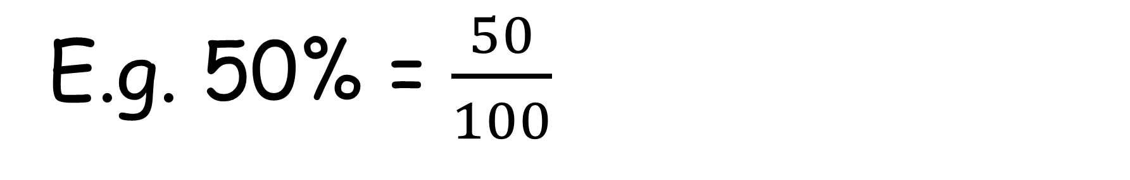
When we learnt about percentages, we learnt that a % can be expressed as a fraction with a denominator of 100.
WALT: Recognise that fractions, decimals and percentages can have equivalent values.
E.g. 50% = $\frac{50}{100}$

Slide 6
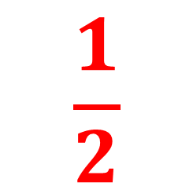

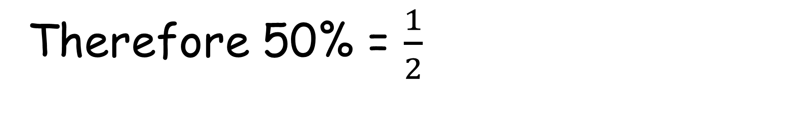
Last lesson, we learnt how to simplify fractions.
WALT: Recognise that fractions, decimals and percentages can have equivalent values.
What is $\frac{50}{100}$ in its simplest form?
$$\frac{1}{2}$$
Therefore 50% = $\frac{1}{2}$

Slide 7
Decimals can also be equivalent to fractions and percentages.
WALT: Recognise that fractions, decimals and percentages can have equivalent values.
If we write one whole to 2 decimal places, what does it look like?
1.00

Slide 8
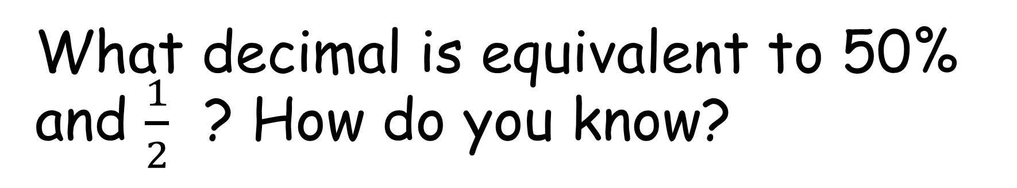
Decimals can also be equivalent to fractions and percentages.
WALT: Recognise that fractions, decimals and percentages can have equivalent values.
What decimal is equivalent to 50% and $\frac{1}{2}$ ? How do you know?
0.5

Slide 9
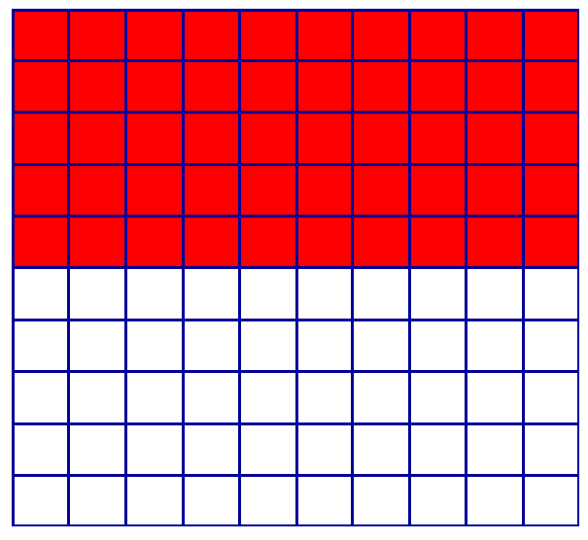
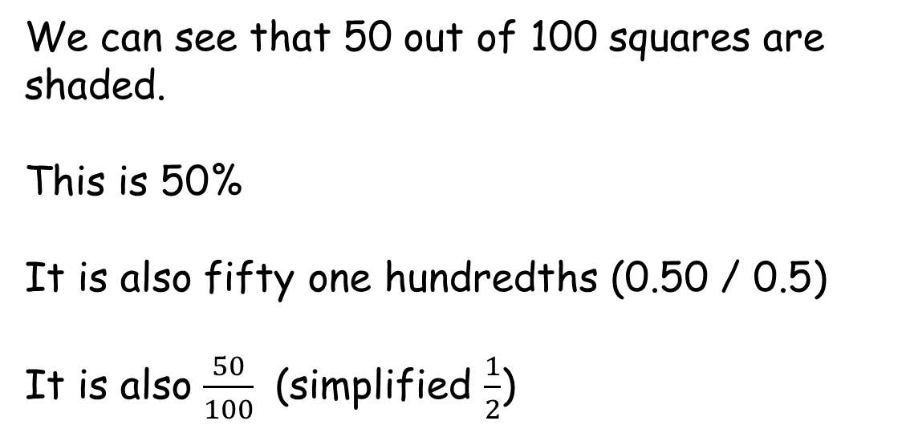
We can see the equivalence more clearly when we look on a square divided into 100 parts.
WALT: Recognise that fractions, decimals and percentages can have equivalent values.
We can see that 50 out of 100 squares are shaded.
This is 50%
It is also fifty one hundredths (0.50 / 0.5)
It is also $\frac{50}{100}$ (simplified $\frac{1}{2}$)

Slide 10

WALT: Recognise that fractions, decimals and percentages can have equivalent values.
We can also order fractions, percentages and decimals together.
But first, we need to make them all the same type of representation.
$$\frac{6}{20}$$
1.59
0.08
150%

Slide 11
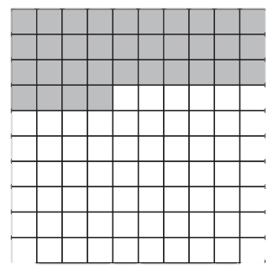

Check Your Understanding
WALT: Recognise that fractions, decimals and percentages can have equivalent values.
Copy and complete this table. Write the fraction in it’s simplest form.
1)
What fraction, percentage and decimal of this square has been shaded?
2)
Fraction | Percentage | Decimal
¼
 |  | 0.4
3) Put these values in order from smallest to greatest.
$$\frac{4}{5}$$
0.79
0.9
81%

Slide 12




Check Your Understanding
WALT: Recognise that fractions, decimals and percentages can have equivalent values.
Copy and complete this table. Write the fraction in it’s simplest form.
1)
What fraction, percentage and decimal of this square has been shaded?
2)
Fraction | Percentage | Decimal
¼
 |  | 0.4
25%
0.25
$$\frac{34}{100}$$
$$\frac{17}{50}$$
34%
0.34
$$\frac{2}{5}$$
40%
$$\frac{4}{5}$$
0.79
81%
0.9
3) Put these values in order from smallest to greatest.
$$\frac{4}{5}$$
0.79
0.9
81%

Slide 13
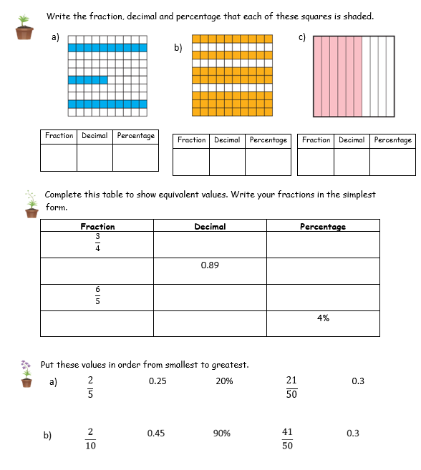
WALT: Recognise that fractions, decimals and percentages can have equivalent values.
Finished everything?
Write your own question that assesses today’s learning objective.

Slide 14
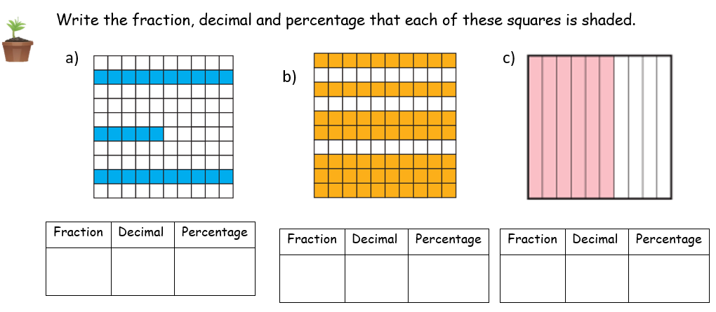






WALT: Recognise that fractions, decimals and percentages can have equivalent values.
$$\frac{25}{100}$$
$$\frac{70}{100}$$
0.25
25%
0.7
70%
$$\frac{60}{100}$$
0.6
60%
$$\frac{1}{4}$$
$$\frac{7}{10}$$
$$\frac{3}{5}$$

Slide 15
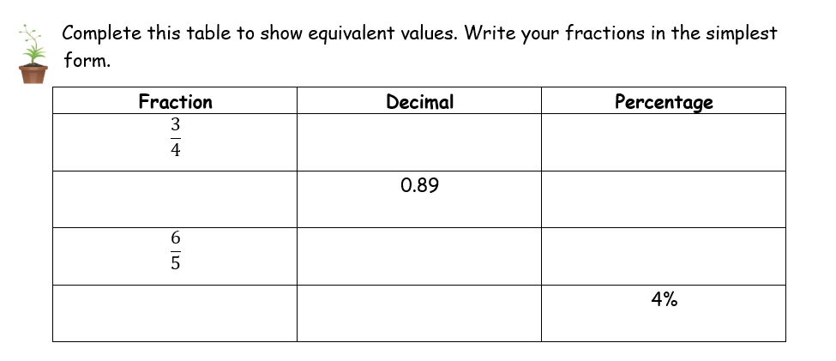


WALT: Recognise that fractions, decimals and percentages can have equivalent values.
0.75
75%
$$\frac{89}{100}$$
89%
1.2
120%
0.04
$$\frac{1}{25}$$

Slide 16
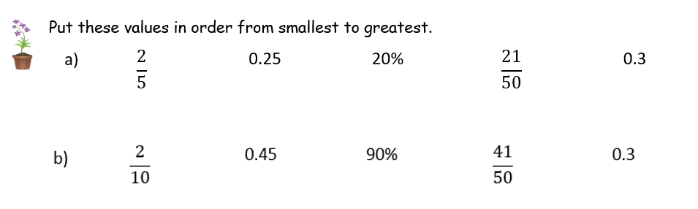




WALT: Recognise that fractions, decimals and percentages can have equivalent values.
$$\frac{2}{5}$$
$$\frac{21}{50}$$
20%
0.25
0.3
0.3
$$\frac{2}{10}$$
0.45
90%
$$\frac{41}{50}$$

Slide 17
WALT: Recognise that fractions, decimals and percentages can have equivalent values.
I can find the fraction, decimal and percentage of a 100 square that is shaded.
I can convert between fractions, decimals and percentages.
I can order a mix of fractions, decimals and percentages.

Slide 18
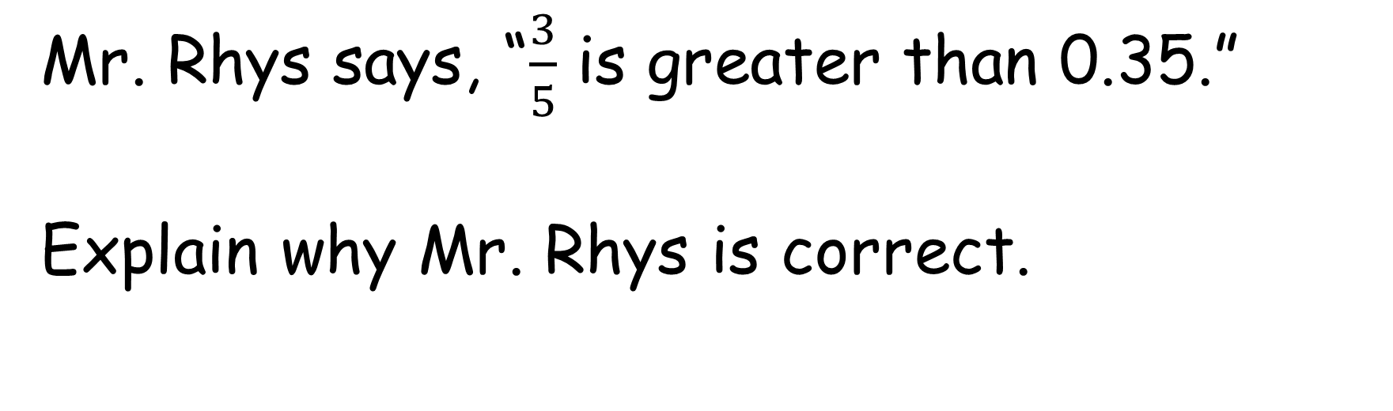
Plenary
WALT: Recognise that fractions, decimals and percentages can have equivalent values.
Mr. Rhys says, “$\frac{3}{5}$ is greater than 0.35.”
Explain why Mr. Rhys is correct.

